Slide 1
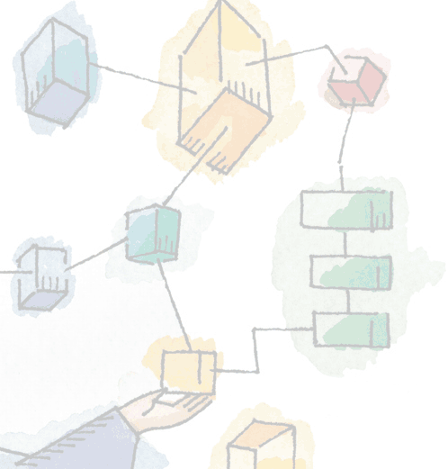
Chapter 18 Distributed Process Management
Operating Systems: Internals and Design Principles, 6/E William Stallings
Notes:
These slides are intended to help a teacher develop a presentation. This PowerPoint covers the entire chapter and includes too many slides for a single delivery. Professors are encouraged to adapt this presentation in ways which are best suited for their students and environment.

Slide 2
Roadmap
Process Migration
Distributed Global States
Distributed Mutual Exclusion
Distributed Deadlock
Notes:
This chapter examines key mechanisms used in distributed operating systems.
First we look at process migration, which is the movement of an active process from one machine to another.
Next, we examine the question of how processes on different systems can coordinate their activities when each is governed by a local clock and when there is a delay in the exchange of information.
Finally,we explore two key issues in distributed process management:
mutual exclusion and
deadlock.

Slide 3
Process Migration
Transfer of sufficient amount of the state of a process from one computer to another
The process executes on the target machine
Notes:
Process migration is the transfer of a sufficient amount of the state of a process from one computer to another for the process to execute on the target machine.

Slide 4
Motivation
Process migration is desirable in distributed computing for several reasons including:
Load sharing
Communications performance
Availability
Utilizing special capabilities

Slide 5
Load Sharing
Move processes from heavily loaded to lightly load systems
Significant improvements are possible
Must be careful that the communications overhead does not exceed the performance gained.
Notes:
Load sharing:
By moving processes from heavily loaded to lightly loaded systems, the load can be balanced to improve overall performance.
significant performance improvements are possible
However, care must be taken in the design of load-balancing algorithms - the more communication necessary for the distributed system to perform the balancing, the worse the performance becomes

Slide 6
Communications performance
Processes that interact intensively can be moved to the same node to reduce communications cost
May be better to move process to the data than vice versa
Especially when the data is larger than the size of the process
Notes:
Communications performance:
Processes that interact intensively can be moved to the same node to reduce communications cost for the duration of
their interaction.
Also, when a process is performing data analysis on some file or set of files larger than the process’s size, it may be advantageous to move the process to the data rather than vice versa.

Slide 7
Availability and Special Capabilities
Availability
Long-running process may need to move because of faults or down time
OS must have advance notice of fault
Utilizing special capabilities
Process can take advantage of unique hardware or software capabilities
Notes:
Availability:
Long-running processes may need to move to survive in the face of faults for which advance notice is possible or in advance of scheduled down-time.
If the operating system provides such notification, a process that wants to continue can either migrate to another system or ensure that it can be restarted on the current system at some later time.
Utilizing special capabilities:
A process can move to take advantage of unique hardware or software capabilities on a particular node.

Slide 8
Migration issues
For process migration to work we need to satisfy a few issues:
Who initiates the migration?
What is involved in a Migration?
What portion of the process is migrated?
What happens to outstanding messages and signals?
Notes:
A number of issues need to be addressed in designing a process migration facility.
Among these are the following:
• Who initiates the migration?
• What portion of the process is migrated?
• What happens to outstanding messages and signals?

Slide 9
Who Initiates Migration?
Depends on the goal or reason for migration
OS initiates
if the goal is load balancing.
May be transparent to process
Process initiates
If the goal is to access a particular resource
Process must be aware of the distributed system
Notes:
Who initiates migration will depend on the goal of the migration facility.
If the goal is load balancing, then some module in the operating system that is monitoring system load will generally be responsible for deciding when migration should take place.
The module will be responsible for preempting or signaling a process to be migrated.
To determine where to migrate, the module will need to be in communication with peer modules in other systems so that the load patterns on other systems can be monitored.
The entire migration function, and indeed the existence of multiple systems, may be transparent to the process.
If the goal is to reach particular resources, then a process may migrate itself as the need arises.
The process must be aware of the existence of a distributed system

Slide 10
What is Involved in Migration?
Must destroy the process on the source system and create it on the target system
Process movement, not replication.
Process image and process control block and any links must be moved
Notes:
When a process is migrated, it is necessary to destroy the process on the source system and create it on the target system.
This is a movement of a process, not a replication.
The process image, consisting of at least the process control block, must be moved.
In addition, any links between this process and other processes, such as for passing messages and signals, must be updated.

Slide 11
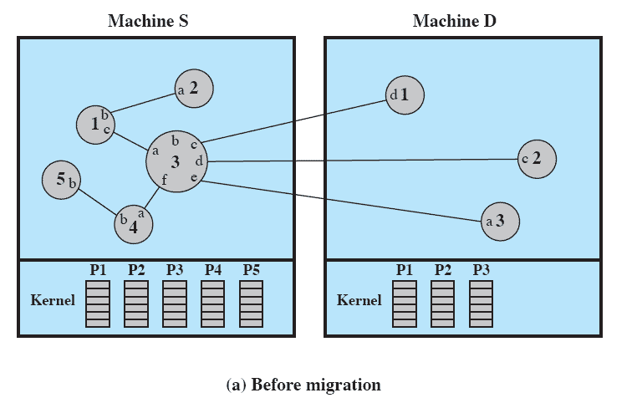
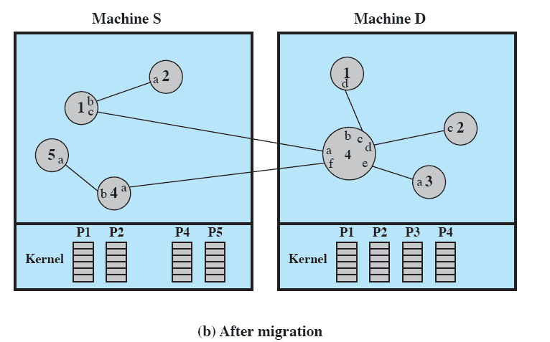
Example of Process Migration
Notes:
ANIMATED SLIDE:
Begins with the BEFORE state maximised then on-click switches to the AFTER
Process 3 has migrated out of machine S to become Process 4 in machine D.
All link identifiers held by processes (denoted in lowercase letters) remain the same as before.
It is the responsibility of the operating system to move the process control block and to update link mappings.
The transfer of the process of one machine to another is invisible to both the migrated process and its communication partners.

Slide 12
What is migrated?
Moving the process control block is simple
Several strategies exist for moving the address space and data including:
Eager (All)
Precopy
Eager (dirty)
Copy-on-reference
Flushing
Notes:
The movement of the process control block is straightforward.
The difficulty, from a performance point of view, concerns the process address space and any open files assigned to the process.

Slide 13
Eager (all)
Transfer entire address space
No trace of process is left behind
If address space is large and if the process does not need most of it, then this approach my be unnecessarily expensive (taking minutes)
Checkpoint/restart capability is useful.
Notes:
Transfer the entire address space at the time of migration.
This is certainly the cleanest approach.
No trace of the process need be left behind at the old system.
However, if the address space is very large and if the process is likely not to need most of it, then this may be unnecessarily expensive.
Initial costs of migration may be on the order of minutes.
Implementations that provide a checkpoint/restart facility are likely to use this approach, because it is simpler to do the check-pointing and restarting if all of the address space is localized.

Slide 14
Precopy
Process continues to execute on the source node while the address space is copied
Pages modified on the source during precopy operation have to be copied a second time
Reduces the time that a process is frozen and cannot execute during migration
Notes:
The process continues to execute on the source node while the address space is copied to the target node.
Pages modified on the source during the precopy operation have to be copied a second time.
This strategy reduces the time that a process is frozen and cannot execute during migration.

Slide 15
Eager (dirty)
Transfer only that portion of the address space that is in main memory and have been modified
Any additional blocks of the virtual address space are transferred on demand
The source machine is involved throughout the life of the process
Maintains page and/or segment table entries.
Notes:
Transfer only those pages of the address space that are in main memory and have been modified.
Any additional blocks of the virtual address space will be transferred on demand only.
This minimizes the amount of data that are transferred.
The source machine must continue to be involved in the life of the process by maintaining page and/or segment table entries and it requires remote paging support.

Slide 16
Copy-on-reference
Variation of Eager(All)
Pages are only brought over when referenced
Has lowest initial cost of process migration
Notes:
This is a variation of eager (dirty) in which pages are only brought over when referenced.
This has the lowest initial cost of process migration, ranging from a few tens to a few hundreds of microseconds.

Slide 17
Flushing
Pages are cleared from main memory by flushing dirty pages to disk
Pages are accessed as needed from disk
Relieves the source of holding any pages of the migrated process in main memory
Notes:
The pages of the process are cleared from the main memory of the source by flushing dirty pages to disk.
Then pages are accessed as needed from disk instead of from memory on the source node.
This strategy relieves the source of the need to hold any pages of the migrated process in main memory, immediately freeing a block of memory to be used for other processes.

Slide 18
Choosing a Strategy
If the process is not using much address space while on the target machine then better to use
Eager (All)
Precopy
Eager (dirty)
Otherwise use
Copy-on-reference
Flushing
Notes:
If it is likely that the process will not use much of its address space while on the target machine
Then one of the last three strategies makes sense.
For example, the process is only temporarily going to another machine to work on a file and will soon return
On the other hand, if much of the address space will be eventually be accessed while on the target machine,
then the piecemeal transfer of blocks of the address space may be less efficient than simply transferring all of the address space at the time of migration,
using one of the first two strategies.
In many cases, it may not be possible to know in advance whether or not much of the nonresident address space will be needed.
But if processes are structured as threads, and if the basic unit of migration is the thread rather than the process, then a strategy based on remote paging would seem to be the best.

Slide 19
What Happens to Messages and Signals?
Need to have a way to temporarily store outstanding messages and signals during the migration activity and then direct them to the new destination.
May need to maintain forwarding details at the initial site to ensure outstanding messages and signals get through
Notes:
Finally, the fate of messages and signals, is addressed by providing a mechanism for temporarily storing outstanding
messages and signals during the migration activity and then directing them to the new destination.
It may be necessary to maintain forwarding information at the initial site for some time to assure that all outstanding messages and signals get through.

Slide 20
Decision to Migrate
Decision to migrate may be made by a single entity
OS may decide based on load monitoring module
Process may decide based on resource needs
Some systems let the target system participate in the decision.
Negotiated migration
Notes:
Another aspect of process migration relates to the decision about migration.
In some cases, the decision is made by a single entity.
e.g. if load balancing is the goal, a load-balancing module monitors the relative load on various machines and performs migration as necessary to maintain a load balance.
If self-migration is used to allow a process access to special facilities or to large remote files, then the process itself may make the decision.
But, some systems allow the designated target system to participate in the decision.
One reason for this could be to preserve response time for users.
A user at a workstation, for example, might suffer noticeable response time degradation if processes migrate to the user’s system, even if such migration served to provide better overall balance.

Slide 21
Migration by Negotiation
Charlotte is an example system.
Migration policy is responsibility of a Starter utility
Starter utility is also responsible for long-term scheduling and memory allocation
Migration decision must be reached jointly by two Starter processes
one on the source and one on the destination
Notes:
An example of a negotiation mechanism is that found in Charlotte.
Migration policy (when to migrate which process to what destination) is the responsibility of the Starter utility,
which is a process that is also responsible for long-term scheduling and memory allocation.
The Starter can therefore coordinate policy in these three areas.
Each Starter process may control a cluster of machines.
The Starter receives timely and fairly elaborate load statistics from the kernel of each of its machines.

Slide 22
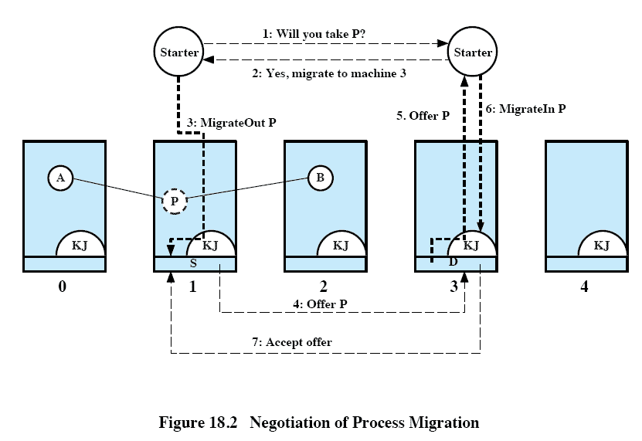
Negotiation of Process Migration
Notes:
The following steps occur:
The Starter that controls the source system (S) decides that a process P should be migrated to a particular destination system (D).
It sends a message to D’s Starter, requesting the transfer.
2. If D’s Starter is prepared to receive the process,
it sends back a positive acknowledgment.
3. S’s Starter communicates this decision to S’s kernel via service call (if the starter runs on S)
or a message to the KernJob (KJ) of machine S (if the starter runs on another machine).
KJ is a process used to convert messages from remote processes into service calls.
4. The kernel on S then offers to send the process to D.
The offer includes statistics about P, such as its age and processor and communication loads.
5. If D is short of resources, it may reject the offer.
Otherwise, the kernel on D relays the offer to its controlling Starter.
The relay includes the same information as the offer from S.
6. The Starter’s policy decision is communicated to D by a MigrateIn call.
7. D reserves necessary resources to avoid deadlock and flow-control problems and then sends an acceptance to S.

Slide 23
Eviction
Destination system may refuse to accept the migration of a process to itself
If a workstation is idle, process may have been migrated to it
Once the workstation is active, it may be necessary to evict the migrated processes to provide adequate response time
Notes:
The negotiation mechanism allows a destination system to refuse to accept the migration of a process to itself.
In addition, it might also be useful to allow a system to evict a process that has been migrated to it.
E.g. if a workstation is idle, one or more processes may be migrated to it.
Once the user of that workstation becomes active, it may be necessary to evict the migrated processes to provide adequate response time.

Slide 24
Preemptive vs. Nonpreemptive Transfers
Previous points related to preemptive processes
Process has been created and may have begun executing
Nonpreemptive process transfers involve processes which have not yet begun
So have no state to transfer
Useful in load balancing.
Notes:
The discussion in this section has dealt with preemptive process migration, which involves transferring a partially executed process, or at least a process whose creation has been completed.
A simpler function is nonpreemptive process transfer, which involves only processes that have not begun execution and hence do not require transferring the state of the process.
In both types of transfer, information about the environment in which the process will execute must be transferred to the remote node.
This may include the user’s current working directory, the privileges inherited by the process, and inherited resources such as file descriptions.
Nonpreemptive process migration can be useful in load balancing.
It has the advantage that it avoids the overhead of full-blown process migration.
The disadvantage is that such a scheme does not react well to sudden changes in load distribution.

Slide 25
Roadmap
Process Migration
Distributed Global States
Distributed Mutual Exclusion
Distributed Deadlock

Slide 26
Distributed Goal State
Operating system cannot know the current state of all process in the distributed system
A process can only know the current state of all processes on the local system
Remote processes only know state information that is received by messages
Notes:
All of the concurrency issues that are faced in a tightly coupled system are also faced in a distributed system.
e.g. such as mutual exclusion, deadlock, and starvation
Design strategies in these areas are complicated by the fact that there is no global state to the system.
IE it is not possible for the operating system, or any process, to know the current state of all processes in the distributed system.
A process can only know the current state of all the processes on the local system, by access to process control blocks in memory.
For remote processes, a process can only know state information that is received via messages, which represent the state of the remote process sometime in the past.

Slide 27
Example
Bank account is distributed over two branches
The total amount in the account is the sum at each branch
At 3 PM the account balance is determined
Messages are sent to request the information
Notes:
The time lags imposed by the nature of distributed systems complicate all issues relating to concurrency.
To illustrate this, we present an example

Slide 28
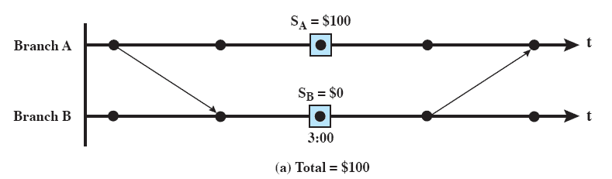
Example 1
Notes:
In these graphs, there is a horizontal line for each process representing the time axis.
A point on the line corresponds to an event
e.g., internal process event, message send, message receive.
A box surrounding a point represents a snapshot of the local process state taken at that point.
An arrow represents a message between two processes.
This figure shows an instance in which a balance of $100.00 in the combined account is found.

Slide 29
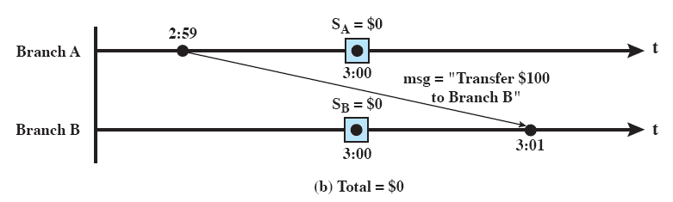
Example 2
If at the time of balance determination, the balance from branch A is in transit to branch B
The result is a false reading
Notes:
But the situation in this figure is also possible.
Here, the balance from branch A is in transit to branch B at the time of observation;
The result is a false reading of $0.00.
This particular problem can be solved by examining all messages in transit at the time of observation.
Branch A will keep a record of all transfers out of the account, together with the identity of the destination of the transfer.
Therefore, we will include in the “state” of a branch A account both the current balance and a record of transfers.
When the two accounts are examined, the observer finds a transfer that has left branch A destined for the customer’s account in branch B.
Because the amount has not yet arrived at branch B, it is added into the total balance.
Any amount that has been both transferred and received is counted only once, as part of the balance at the receiving account.

Slide 30
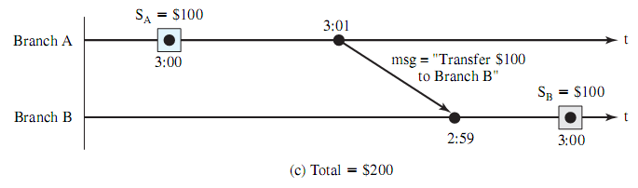
Example 3
All messages in transit must be examined at time of observation
Total consists of balance at both branches and amount in message
Notes:
This strategy is not foolproof, as shown here.
In this example, the clocks at the two branches are not perfectly synchronized.
The state of the customer account at branch A at 3:00 p.m. indicates a balance of $100.00.
However, this amount is subsequently transferred to branch B at 3:01 according to the clock at A but arrives at B at 2:59 according to B’s clock.
Therefore, the amount is counted twice for a 3:00 observation.

Slide 31
Some Terms
Channel
Exists between two processes if they exchange messages
State
Sequence of messages that have been sent and received along channels incident with the process
Notes:
To understand the difficulty we face and to formulate a solution, we need to define the following:
Channel: A channel exists between two processes if they exchange messages.
We can think of the channel as the path or means by which the messages are transferred.
For convenience, channels are viewed as unidirectional.
Thus, if two processes exchange messages, two channels are required, one for each direction of message transfer.
State: The state of a process is the sequence of messages that have been sent and received along channels incident with the process.

Slide 32
Some Terms
Snapshot
Records the state of a process
Global state
The combined state of all processes
Distributed Snapshot
A collection of snapshots, one for each process
Notes:
Snapshot: A snapshot records the state of a process.
Each snapshot includes a record of all messages sent and received on all channels since the last snapshot.
Global State: The combined state of all processes.
Distributed Snapshot: A collection of snapshots, one for each process.

Slide 33
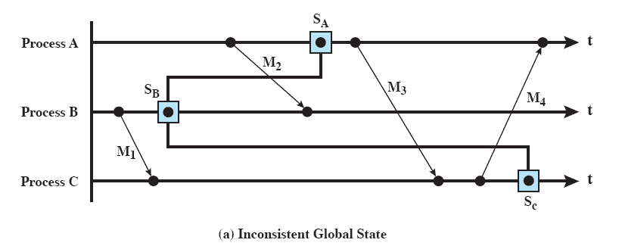
Inconsistent Global State
Notes:
The problem is that a true global state cannot be determined because of the time lapse associated with message transfer.
We can attempt to define a global state by collecting snapshots from all processes.
For example, the global state of this figure at the time of the taking of snapshots shows
a message in transit on the <A,B> channel,
one in transit on the <A,C> channel, and
one in transit on the <C,A> channel.
Messages 2 and 4 are represented appropriately, but message 3 is not.
The distributed snapshot indicates that this message has been received but not yet sent.

Slide 34
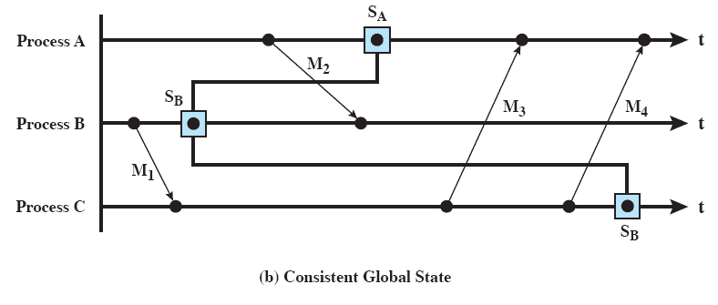
Consistent Global State
Notes:
We desire that the distributed snapshot record a consistent global state.
A global state is consistent if for every process state that records the receipt of a message, the sending of that message is recorded in the process state of the process that sent the message.
This figure gives an example.
An inconsistent global state arises if a process has recorded the receipt of a message but the corresponding sending process has not recorded that the message has been sent.

Slide 35
Distributed Snapshot Algorithm
Records a consistent global state
Assumes messages are delivered in order that they were sent
And no messages are lost
TCP satisfies requirements
Uses a special control message
Marker
Notes:
A distributed snapshot algorithm records a consistent global state.
The algorithm assumes that messages are delivered in the order that they are sent and that no messages are lost.
A reliable transport protocol (e.g., TCP) satisfies these requirements.
The algorithm makes use of a special control message, called a marker.

Slide 36
Roadmap
Process Migration
Distributed Global States
Distributed Mutual Exclusion
Distributed Deadlock

Slide 37
Concurrent Process Problems
Two main problems with concurrent processing are:
Mutual Exclusion
Deadlock
Ch5/6 looked at issues within a single computer
Different issues arise when the processors do not share common memory or clock
Notes:
Two key problems that arose were those of mutual exclusion and deadlock.
In dealing with a distributed operating system and a collection of processors that do not share common main memory or clock, new difficulties arise and new solutions are called for.
Algorithms for mutual exclusion and deadlock must depend on the exchange of messages and cannot depend on access to common memory.

Slide 38
Critical Section
Non-sharable resources are critical resources
Code accessing it is a critical section of a program
Mutual exclusion must be enforced:
only one process at a time is allowed in its critical section
Notes:
When two or more processes compete for the use of system resources, there is a need for a mechanism to enforce mutual exclusion.
Suppose that two or more processes require access to a single nonsharable resource, such as a printer.
During the course of execution, each process will be sending commands to the I/O device, receiving status information, sending data, and/or receiving data.
This is a critical resource, and the portion of the program that uses it as a critical section of the program.
It is important that only one program at a time be allowed in its critical section.
We cannot simply rely on the operating system to understand and enforce this restriction, because the detailed requirement may not be obvious.
e.g. a printer, we wish any individual process to have control of the printer while it prints an entire file.
Otherwise, lines from competing processes will be interleaved.
The successful use of concurrency among processes requires the ability to define critical sections and enforce mutual exclusion.
This is fundamental for any concurrent processing scheme.

Slide 39
Distributed Mutual Exclusion Requirements
Mutual exclusion must be enforced
A process halting in noncritical section must not interfere with other processes
A process requiring access to a critical section should not be delayed indefinitely
Deadlock and starvation are not allowed
Notes:
Mutual exclusion must be enforced:
Only one process at a time is allowed into its critical section, among all processes that have critical sections for the same resource or shared object.
2. A process that halts in its noncritical section must do so without interfering with other processes.
3. It must not be possible for a process requiring access to a critical section to be delayed indefinitely:
no deadlock or starvation.

Slide 40
Distributed Mutual Exclusion Requirements
If no process is in a critical section, any process may enter without delay
No assumption about the number of processors
A process remains inside its critical section for a finite time only.
Notes:
4. When no process is in a critical section, any process that requests entry to its critical section must be permitted to enter without delay.
5. No assumptions are made about relative process speeds or number of processors.
6. A process remains inside its critical section for a finite time only.

Slide 41
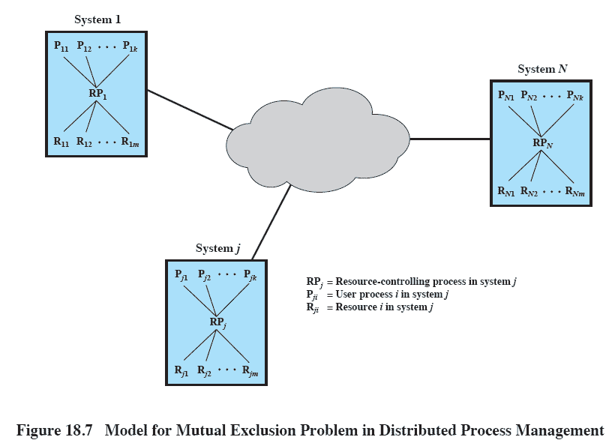
Mutual Exclusion
Notes:
This figure shows a model that we can use for examining approaches to mutual exclusion in a distributed context.
We assume a number of systems connected by a network of some kind.
Within each system, we assume that some function or process within the operating system is responsible for resource allocation.
Each such process controls a number of resources and serves a number of user processes.
The task is to devise an algorithm by which these processes may cooperate in enforcing mutual exclusion.

Slide 42
Centralized Algorithm for Mutual Exclusion
One node is designated as the control node
This node control access to all shared objects
Only the control node makes resource-allocation decision
Notes:
In a fully centralized algorithm, one node is designated as the control node and controls access to all shared objects.
When any process requires access to a critical resource, it issues a Request to its local resource-controlling process.
This process, in turn, sends a Request message to the control node, which returns a Reply (permission) message when the shared object becomes available.
When a process has finished with a resource, a Release message is sent to the control node.

Slide 43
Properties of a Centralized Method
Only the control node makes resource-allocation decisions.
All information is located in the control node
If control node fails, mutual exclusion breaks down
Notes:
Such a centralized algorithm has two key properties:
1. Only the control node makes resource-allocation decisions.
2. All necessary information is concentrated in the control node, including the identity and location of all resources and the allocation status of each resource.

Slide 44
Distributed Algorithm
All nodes have equal amount of information, on average
Each node has only a partial picture of the total system and must make decisions based on this information
All nodes bear equal responsibility for the final decision
Notes:
A fully distributed algorithm is characterized by the following properties:
All nodes have an equal amount of information, on average.
2. Each node has only a partial picture of the total system and must make decisions based on this information.
Some distributed algorithms require that all information known to any node be communicated to all other nodes.
Even then, at any given time, some of that information will be in transit and will not have arrived at all of the other nodes.
Because of time delays in message communication, a node’s information is usually not completely up to date and is in that sense only partial information.
3. All nodes bear equal responsibility for the final decision.

Slide 45
Distributed Algorithm
All nodes expend equal effort, on average, in effecting a final decision
Failure of a node, in general, does not result in a total system collapse
There exits no system-wide common clock with which to regulate the time of events
Notes:
4. All nodes expend equal effort, on average, in effecting a final decision.
5. Failure of a node, in general, does not result in a total system collapse.
6. There exists no system-wide common clock with which to regulate the timing of events.
because of the delay in communication among systems, it is impossible to maintain a system-wide clock that is instantly available to all systems.
It is also technically impractical to maintain one central clock and to keep all local clocks synchronized precisely to that central clock; over a period of time, there will be some drift among the various local clocks that will cause a loss of synchronization.
It is the delay in communication, coupled with the lack of a common clock, that makes it much more difficult to develop mutual exclusion mechanisms in a distributed system compared to a centralized system.

Slide 46
Ordering of Events in a Distributed System
Events must be order to ensure mutual exclusion and avoid deadlock
But clocks are not synchronized
Communication delays affect timing decisions
Notes:
The temporal ordering of events is fundamental to the operation of most distributed algorithms for mutual exclusion and deadlock.
The lack of a common clock or a means of synchronizing local clocks is thus a major constraint.
The problem can be expressed in the following manner.
We would like to be able to say that an event a at system i occurred before (or after) event b at system j,
and we would like to be able to arrive consistently at this conclusion at all systems in the network.
BUT, there may be a delay between the actual occurrence of an event and the time that it is observed on some other system.
Second, the lack of synchronization leads to a variance in clock readings on different systems.

Slide 47
Timestamping
Each system on the network maintains a counter which functions as a clock
Each site has a numerical identifier
When a message is received, the receiving system sets is clock to one more than the maximum of its current value and the incoming timestamp
Notes:
Timestamping orders events in a distributed system without using physical clocks.
This technique is so efficient and effective that it is used in the great majority of algorithms for distributed mutual exclusion and deadlock.

Slide 48
Timestamping is Ordering Messages
Each system i has a counter C_{i} functioning as a clock
Each message increments C_{i}
Messages sent in the form (m, T_{i}, i) where
m = contents of the message
T_{i} = timestamp for this message, set to equal C_{i}
i = numerical identifier of this system in the distributed system
Notes:
The timestamping scheme is intended to order events consisting of the transmission of messages.
Each system i in the network maintains a local counter, C_{i} which functions as a clock.
Each time a system transmits a message, it first increments its clock by 1.
The message is sent in the form (m,T_{i} ,i) where
m = contents of the message
T_{i} = timestamp for this message, set to equal C_{i}
i = numerical identifier of this system in the distributed system

Slide 49
Receiving System
The receiving system j increments its clock to one more than the maximum of its current value and the incoming timestamp:
C_{j} ← 1 + max[Cj, T_{i} ]
If i sends x, and j sends y then x comes before y
If T_{i} < T_{j} or
If T_{i} = T_{j} AND i < j
Notes:
When a message is received, the receiving system sets its clock to one more than the maximum of its current value and the incoming timestamp:
C_{j} ← 1 + max[Cj, T_{i} ]
At each site, the ordering of events is determined by the following rules.
For a message x from site i and a message y from site j, then
x is said to precede y
If T_{i} < T_{j} or
If T_{i} = T_{j} AND i < j

Slide 50
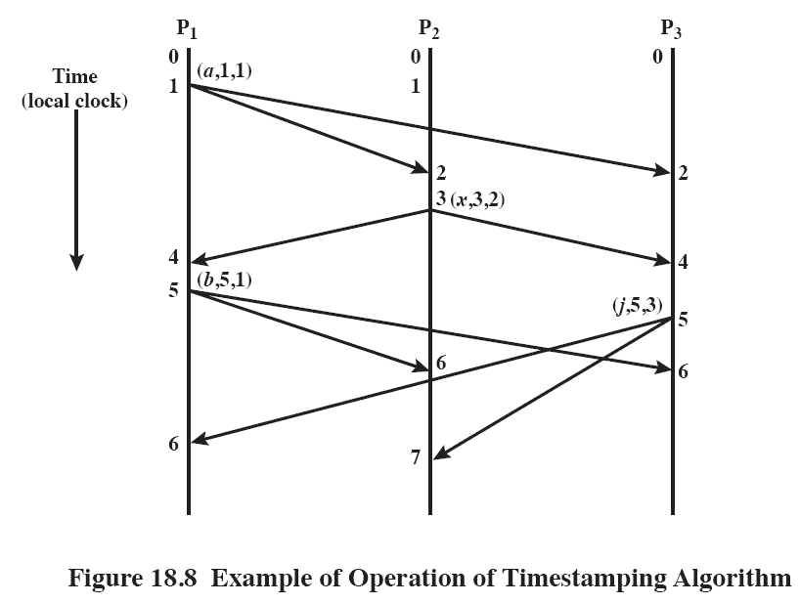
Timestamping
Notes:
There are three sites, each of which is represented by a process that controls the timestamping algorithm.
Process P₁ begins with a clock value of 0.
To transmit message a, it increments its clock by 1 and transmits (a, 1, 1), where the first numerical value is the timestamp and the second is the identity of the site.
This message is received by processes at sites 2 and 3.
In both cases, the local clock has a value of zero and is set to a value of:
2 = 1 + max[0, 1].
P₂ issues the next message, first incrementing its clock to 3.
Upon receipt of this message, P₁ and P₃ increment their clocks to 4.
Then P₁ issues message b and P₃ issues message j at about the same time and with the same timestamp.
Because of the ordering principle outlined previously, this causes no confusion.
After all of these events have taken place, the ordering of messages is the same at all sites, namely {a, x, b, j}.

Slide 51
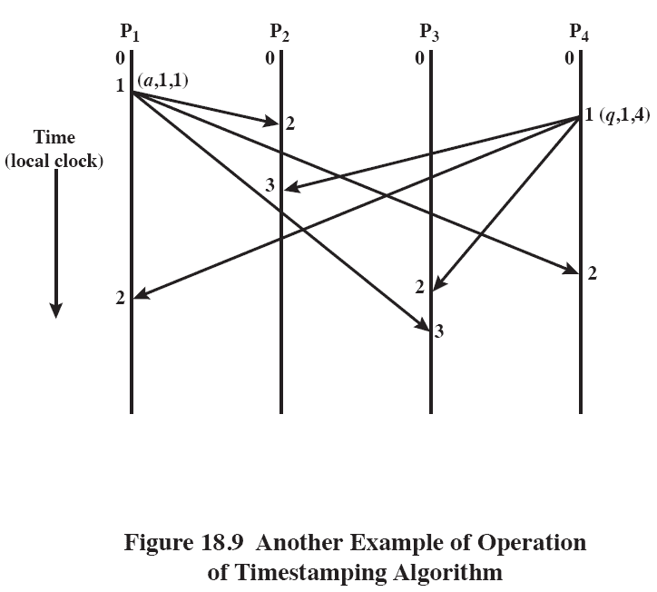
Timestamping
Notes:
The algorithm works in spite of differences in transmission times between pairs of systems
Here, P₁ and P₄ issue messages with the same timestamp.
The message from P₁ arrives earlier than that of P₄ at site 2 but later than that of P₄ at site 3.
Nevertheless, after all messages have been received at all sites, the ordering of messages is the same at all sites: {a, q}.

Slide 52
Distributed Queue
An early approach to distributed mutual exclusion uses a distributed queue
Relied on several assumptions
Each node (1..N) has 1 process to manage mutual exclusion
Messages arrive in the same order as sent (this assumption relaxed in later versions)
Every message is successfully received
Network is fully connected
Notes:
One of the earliest proposed approaches to providing distributed mutual exclusion is based on the concept of a distributed queue
Assumptions:
1. A distributed system consists of N nodes, uniquely numbered from 1 to N.
Each node contains one process that makes requests for mutually exclusive access to resources on behalf of other processes;
this process also serves as an arbitrator to resolve incoming requests from other nodes that overlap in time.
2. Messages sent from one process to another are received in the same order in which they are sent.
3. Every message is correctly delivered to its destination in a finite amount of time.
4. The network is fully connected;
this means that every process can send messages directly to every other process, without requiring an intermediate process to forward the message.

Slide 53
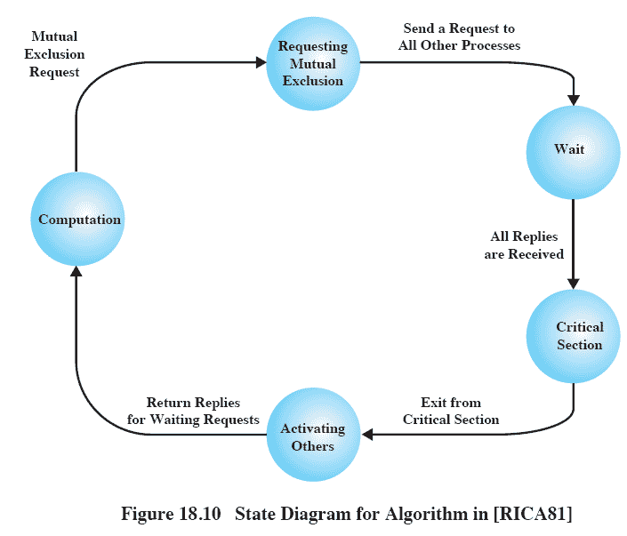
State Diagram
Notes:
When a process wishes to enter its critical section, it sends a timestamped Request message to all other processes.
When it receives a Reply from all other processes, it may enter its critical section.
When a process receives a Request from another process, it must eventually send a matching Reply.
If a process does not wish to enter its critical section, it sends a Reply at once.
If it wants to enter its critical section, it compares the timestamp of its Request with that of the last Request received, and if the latter is more recent, it defers its Reply;
Otherwise Reply is sent at once.
With this method, 2(N - 1) messages are required:
(N - 1) Request messages to indicate P_{i}’s intention of entering its critical section, and
(N - 1) Reply messages to allow the access it has requested.

Slide 54
Token-Passing Approach
Pass a token among the participating processes
The token is an entity that at any time is held by one process
The process holding the token may enter its critical section without asking permission
When a process leaves its critical section, it passes the token to another process
Notes:
A quite different approach to mutual exclusion, involves passing a token among the participating processes.
The token is an entity that at any time is held by one process.
The process holding the token may enter its critical section without asking permission.
When a process leaves its critical section, it passes the token to another process.

Slide 55
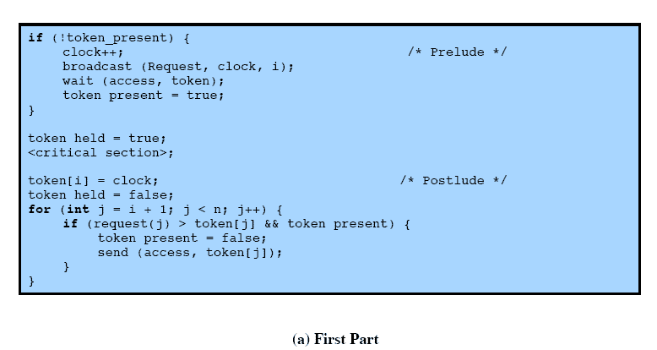
Token-Passing
Notes:
The algorithm is in two parts
The first part deals with the use of the critical section and consists of
a prelude,
followed by the critical section,
followed by a postlude.
The algorithm requires either of the following:
N messages (N - 1 to broadcast the request and 1 to transfer the token) when the requesting process does not hold the token
No messages, if the process already holds the token

Slide 56
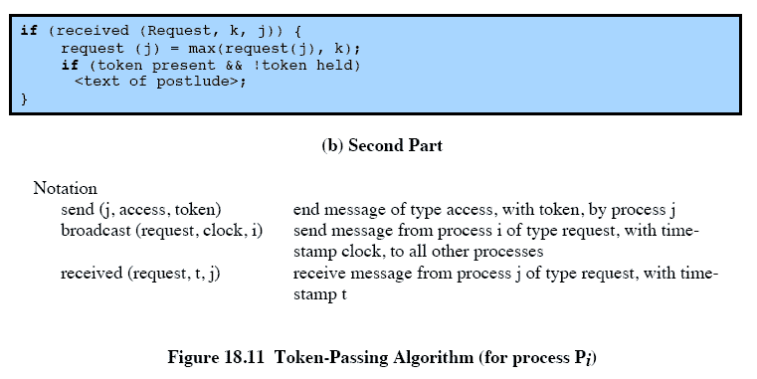
Token Passing
Notes:
The second part concerns the action to be taken upon receipt of a request.
The variable clock is the local counter used for the timestamp function.
The operation wait (access, token) causes the process to wait until a message of the type “access” is received, which is then put into the variable array token.

Slide 57
Roadmap
Process Migration
Distributed Global States
Distributed Mutual Exclusion
Distributed Deadlock

Slide 58
Deadlock
The permanent blocking of a set of processes that either compete for system resources or communicate with one another.
Definition valid for distributed systems as much as for single
More complex as no node as knowledge of the state of the overall system
Notes:
In Ch6 we defined deadlock as:
the permanent blocking of a set of processes that either compete for system resources or communicate with one another.
This definition is valid for a single system as well as for a distributed system.
As with mutual exclusion, deadlock presents more complex problems in a distributed system, compared with a shared memory system.
Deadlock handling is complicated in a distributed system because no node has accurate knowledge of the current state of the overall system and because every message transfer between processes involves an unpredictable delay.

Slide 59
Types of Deadlock
Those related to resource allocation
Multiple processes attempt to access the same resource
Communication of messages
Each process in a set is waiting for a message from another process in the set,
No process sends a message.
Notes:
Two types of distributed deadlock:
those that arise in the allocation of resources, and
those that arise with the communication of messages.
In resource deadlocks,
processes attempt to access resources, such as data objects in a database or I/O resources on a server;
deadlock occurs if each process in a set of processes requests a resource held by another process in the set.
In communications deadlocks,
messages are the resources for which processes wait;
deadlock occurs if each process in a set is waiting for a message from another process in the set and no process in the set ever sends a message.

Slide 60
Deadlock in Resource Allocation
Deadlock required:
Mutual exclusion
Hold and wait
No preemption
Circular wait
In a distributed system there is no control process with an up-to-date knowledge of the global state of the system.
Notes:
Mutual exclusion:
Only one process may use a resource at a time.
No process may access a resource unit that has been allocated to another process.
Hold and wait:
A process may hold allocated resources while awaiting assignment of others.
No preemption:
No resource can be forcibly removed from a process holding it.
Circular wait:
A closed chain of processes exists, such that each process holds at least one resource needed by the next process in the chain.
The aim of an algorithm that deals with deadlock is either to prevent the formation of a circular wait or to detect its actual or potential occurrence.
In a distributed system, the resources are distributed over various sites and access to them is regulated by control processes that do not have complete, up-to-date knowledge of the global state of the system and must therefore make their decisions on the basis of local information.

Slide 61
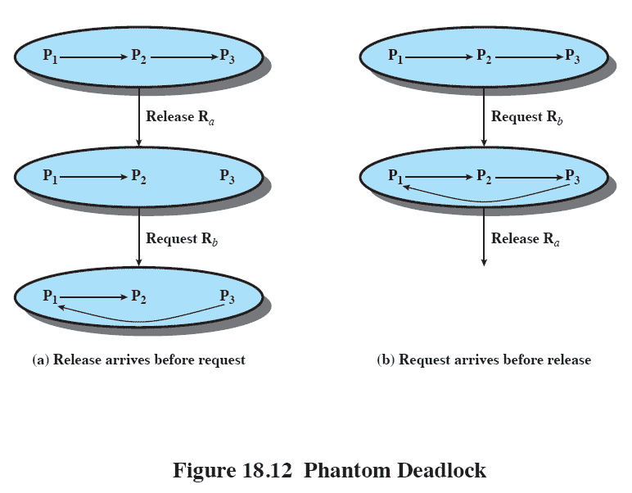
Phantom Deadlock
Notes:
One example of the difficulty faced in distributed deadlock management is the phenomenon of phantom deadlock.
The notation P1 → P2 → P3 means that P1 is halted waiting for a resource held by P2, and P2 is halted waiting for a resource held by P3.
NOTE P3 owns resource Ra and P1 owns resource Rb.
Suppose now that P3 issues first a message releasing Ra and then a message requesting Rb.
If the first message reaches a cycle-detecting process before the second, the sequence of Figure 18.12a results,
which properly reflects resource requirements.
If, however, the second message arrives before the first message, a deadlock is registered (Figure 18.12b).
This is a false detection, not a real deadlock, due to the lack of a global state, such as would exist in a centralized system.

Slide 62
Deadlock Prevention
Circular-wait condition can be prevented by defining a linear ordering of resource types
Hold-and-wait condition can be prevented by requiring that a process request all of its required resource at one time, and blocking the process until all requests can be granted simultaneously
Notes:
The circular-wait condition can be prevented by defining a linear ordering of resource types.
If a process has been allocated resources of type R, then it may subsequently request only those resources of types following R in the ordering.
A major disadvantage of this method is that resources may not be requested in the order in which they are used;
thus resources may be held longer than necessary.
The hold-and-wait condition can be prevented by requiring that a process request all of its required resources at one time, and blocking the process until all requests can be granted simultaneously.
This approach is inefficient in two ways.
First, a process may be held up for a long time waiting for all of its resource requests to be filled, when in fact it could have proceeded with only some of the resources.
Second, resources allocated to a process may remain unused for a considerable period, during which time they are denied to other processes.

Slide 63
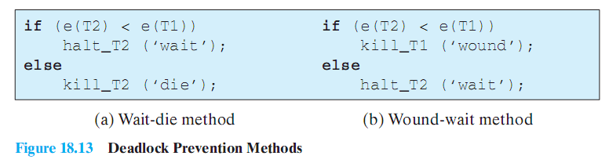
Deadlock Prevention Methods
Notes:
The proposed methods make use of timestamps.
Each transaction carries throughout its lifetime the timestamp of its creation.
This establishes a strict ordering of the transactions.
If a resource R already being used by transaction T1 is requested by another transaction T2, the conflict is resolved by comparing their timestamps.
Let us suppose that T1 currently holds R and that T2 issues a request.
For the wait-die method, Figure 18.13a shows the algorithm used by the resource allocator at the site of R.
The timestamps of the two transactions are denoted as e(T1) and e(T2).
If T2 is older, it is blocked until T1 releases R, either by actively issuing a release or by being “killed” when requesting another resource.
If T2 is younger, then T2 is restarted but with the same timestamp as before.
Thus, in a conflict, the older transaction takes priority. Because a killed transaction is revived with its original timestamp it grows older and therefore gains increased priority.
No site needs to know the state of allocation of all resources.
All that are required are the timestamps of the transactions that request its resources.
The wound-wait method immediately grants the request of an older transaction by killing a younger transaction that is using the required resource.
This is shown in Figure 18.13b.
In contrast to the wait-die method, a transaction never has to wait for a resource being used by a younger transaction.

Slide 64
Deadlock Avoidance
Distributed deadlock avoidance is impractical
Every node must keep track of the global state of the system
The process of checking for a safe global state must be mutually exclusive
Checking for safe states involves considerable processing overhead
Notes:
Deadlock avoidance is a technique in which a decision is made dynamically whether a given resource allocation request could, if granted,
lead to a deadlock.
Distributed deadlock avoidance is impractical for the following reasons:
Every node must keep track of the global state of the system;
this requires substantial storage and communications overhead.
2. The process of checking for a safe global state must be mutually exclusive.
Otherwise, two nodes could each be considering the resource request of a different process and concurrently reach the conclusion that it is safe to honor the request, when in fact if both requests are honored, deadlock will result.
3. Checking for safe states involves considerable processing overhead for a distributed system with a large number of processes and resources.

Slide 65
Deadlock Detection
Processes are allowed to obtain free resources as they wish, and the existence of a deadlock is determined after the fact.
Each site only knows about its own resources
But deadlock may involve distributed resources.
Notes:
With deadlock detection, processes are allowed to obtain free resources as they wish, and the existence of a deadlock is determined after the
fact.
If a deadlock is detected, one of the constituent processes is selected and required to release the resources necessary to break the deadlock.
The difficulty with distributed deadlock detection is that each site only knows about its own resources, whereas a deadlock may involve distributed resources.

Slide 66
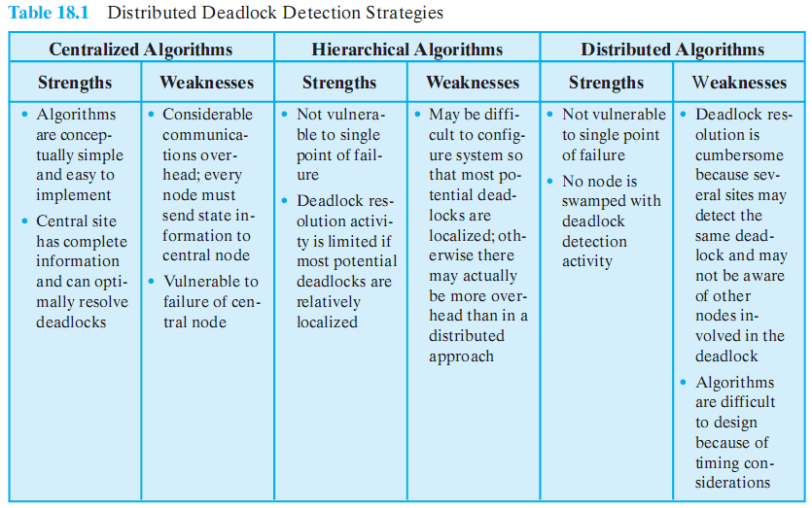
Deadlock Detection Strategies

Slide 67
Deadlock Detection
Centralized control
one site is responsible for deadlock detection
Hierarchical control
sites organized in a tree structure
Distributed control
all processes cooperate in the deadlock detection function
Notes:
With centralized control, one site is responsible for deadlock detection.
All request and release messages are sent to the central process as well as to the process that controls the particular resource.
Because the central process has a complete picture, it is in a position to detect a deadlock.
This approach requires a lot of messages and is vulnerable to a failure of the central site. In addition, phantom deadlocks may be detected.
With hierarchical control, the sites are organized in a tree structure, with one site serving as the root of the tree.
At each node, other than leaf nodes, information about the resource allocation of all dependent nodes is collected.
This permits deadlock detection to be done at lower levels than the root node.
Specifically, a deadlock that involves a set of resources will be detected by the node that is the common ancestor of all sites whose resources are among the objects in conflict.
With distributed control, all processes cooperate in the deadlock detection function.
In general, this means that considerable information must be exchanged, with timestamps; thus the overhead is significant.

Slide 68
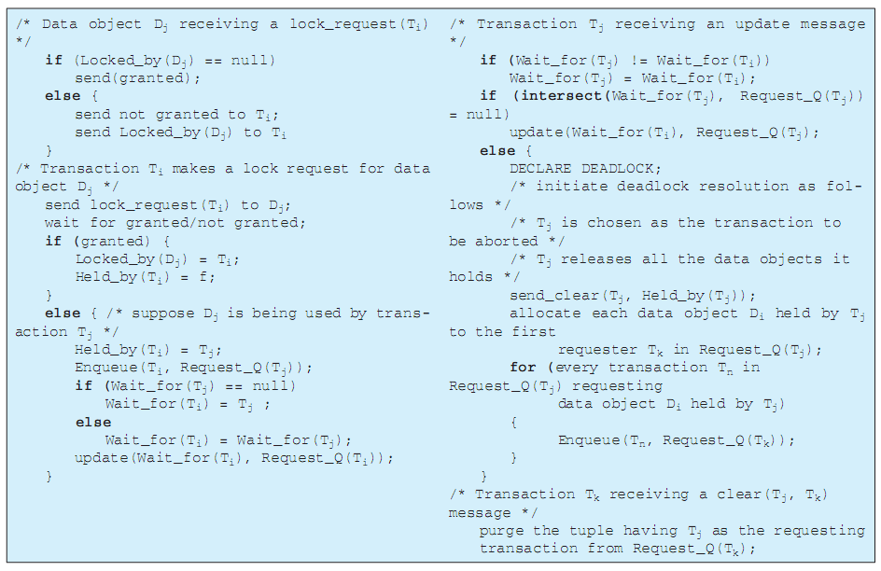
Distributed Deadlock Detection
Notes:
This figure shows the algorithm used for deadlock detection.
When a transaction makes a lock request for a data object, a server process associated with that data object either grants or denies the request.
If the request is not granted, the server process returns the identity of the transaction holding the data object.
The algorithm deals with a distributed database system in which each site maintains a portion of the database and transactions may be initiated from each site.
A transaction can have at most one outstanding resource request.
If a transaction needs more than one data object, the second data object can be requested only after the first data object has been granted.

Slide 69
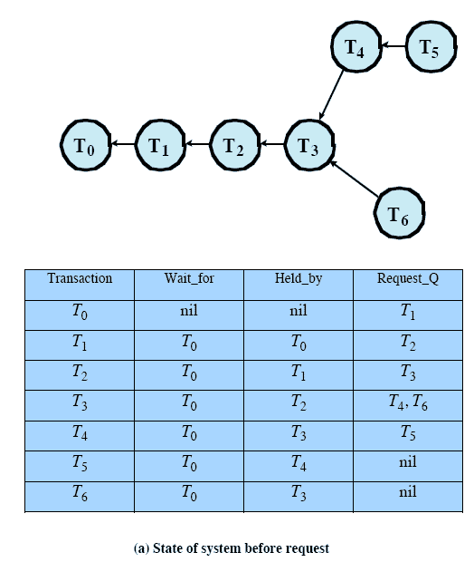
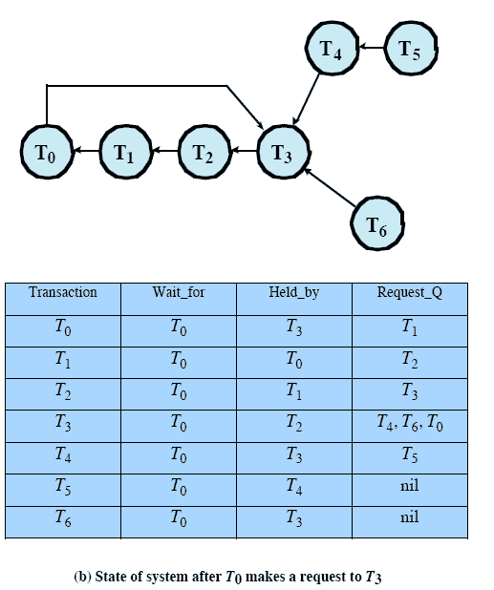
Distributed Deadlock Detection States
Notes:
When T₀ makes a request for a data object held by T₃, a cycle is created.
T₀ issues an update message that propagates from T₁ to T₂ to T₃.
At this point,T₃ discovers that the intersection of its Wait_for and Request_Q variables is not empty.
T₃ sends a clear message to T₂ so that T₃ is purged from Request_Q(T₂), and it releases the data objects it held, activating T₄ and T₆.

Slide 70
Deadlock in Message Communication
Types
Mutual Waiting deadlock
Unavailability of Message Buffers

Slide 71
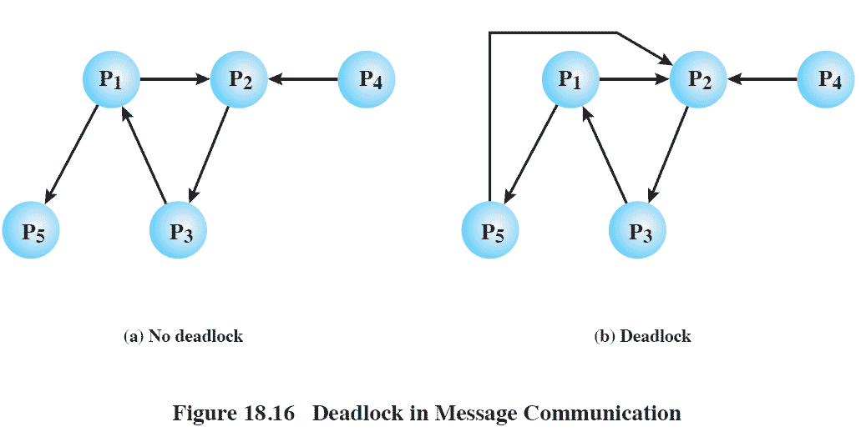
Mutual Waiting Deadlock
Each process in a group is waiting for another member of the group
And no messages are in transit
Notes:
Mutual Waiting Deadlock occurs in message communication when each of a group of processes is waiting for a message from another member of the group and there are no messages in transit.

Slide 72
Unavailability of Message Buffers
Common in packet-switching networks
Simplest forms
Store and forward deadlock
For each node, the queue to the adjacent node in one direction is full with packets destined for the next node beyond
Notes:
Another way in which deadlock can occur in a message-passing system has to do with the allocation of buffers for the storage of messages in transit.
This kind of deadlock is well known in packet-switching data networks.
The simplest form of deadlock in a data network is direct store-and-forward deadlock and can occur if a packet-switching node uses a common buffer pool from which buffers are assigned to packets on demand.

Slide 73
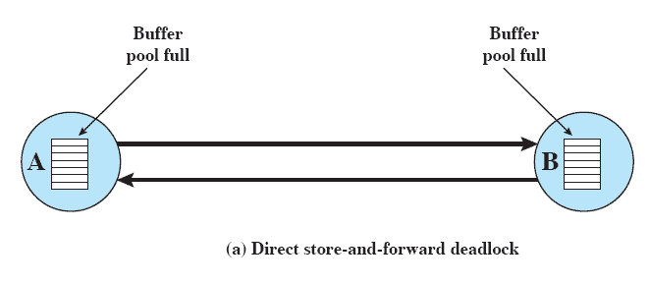
Direct Store-and-Forward Deadlock
Notes:
This figure shows a situation in which all of the buffer space in node A is occupied with packets destined for B.
The reverse is true at B.
Neither node can accept any more packets because their buffers are full.
Thus neither node can transmit or receive on any link.
Direct store-and-forward deadlock can be prevented by not allowing all buffers to end up dedicated to a single link. Using separate fixed-size buffers, one for each link, will achieve this prevention.
Even if a common buffer pool is used, deadlock is avoided if no single link is allowed to acquire all of the buffer space.

Slide 74
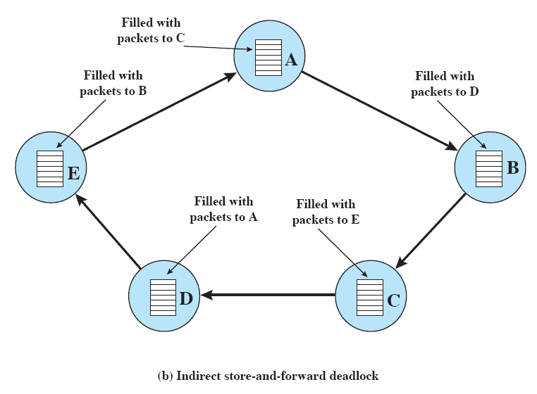
Indirect Store-and-Forward Deadlock
Notes:
A more subtle form of deadlock, indirect store-and-forward deadlock, is shown here.
For each node, the queue to the adjacent node in one direction is full with packets destined for the next node beyond.

Slide 75
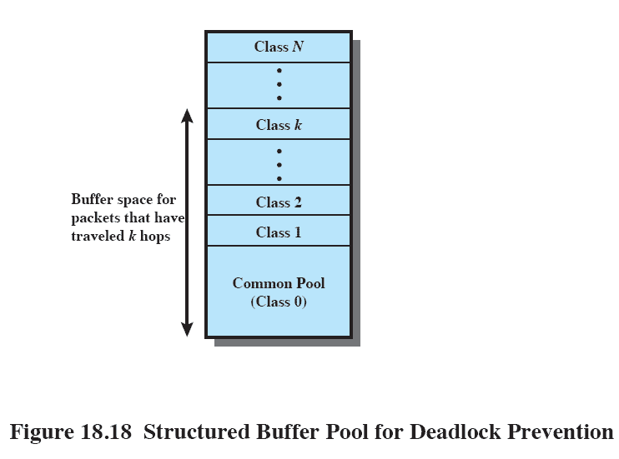
Structured Buffer Pool
Notes:
One simple way to prevent this type of deadlock is to employ a structured buffer pool.
The buffers are organized in a hierarchical fashion.
The pool of memory at level 0 is unrestricted;
any incoming packet can be stored there.
From level 1 to level N (where N is the maximum number of hops on any network path), buffers are reserved in the following way:
Buffers at level k are reserved for packets that have travelled at least k hops so far.
Thus, in heavy load conditions, buffers fill up progressively from level 0 to level N.
If all buffers up through level k are filled, arriving packets that have covered k or less hops are discarded.
This strategy eliminates both direct and indirect store-and-forward deadlocks.

Slide 76
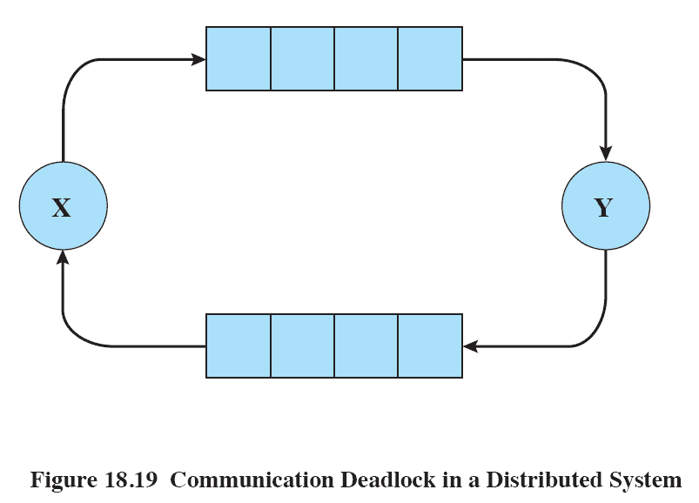
Communication Deadlock
Notes:
This figure illustrates how the use of finite channels can lead to deadlock.
The figure shows two channels, each with a capacity of four messages, one from process X to process Y, and one from Y to X.
If exactly four messages are in transit in each of the channels and both X and Y attempt a further transmission before executing a receive, then both are suspended and a deadlock arises.
If it is possible to establish upper bounds on the number of messages that will ever be in transit between each pair of processes in the system, then the obvious prevention strategy would be to allocate as many buffer slots as needed for all these channels.
This might be extremely wasteful and of course requires this foreknowledge.
If requirements cannot be known ahead of time, or if allocating based on upper bounds is deemed too wasteful, then some estimation technique is needed to optimize the allocation.
This problem is unsolvable in the general case.

